Slide 1

Dart Programming Language
Wenxuan Shi
College of Software, Nankai University
Email: shiwx@nankai.edu.cn
Wechat: 13920561100

Slide 2
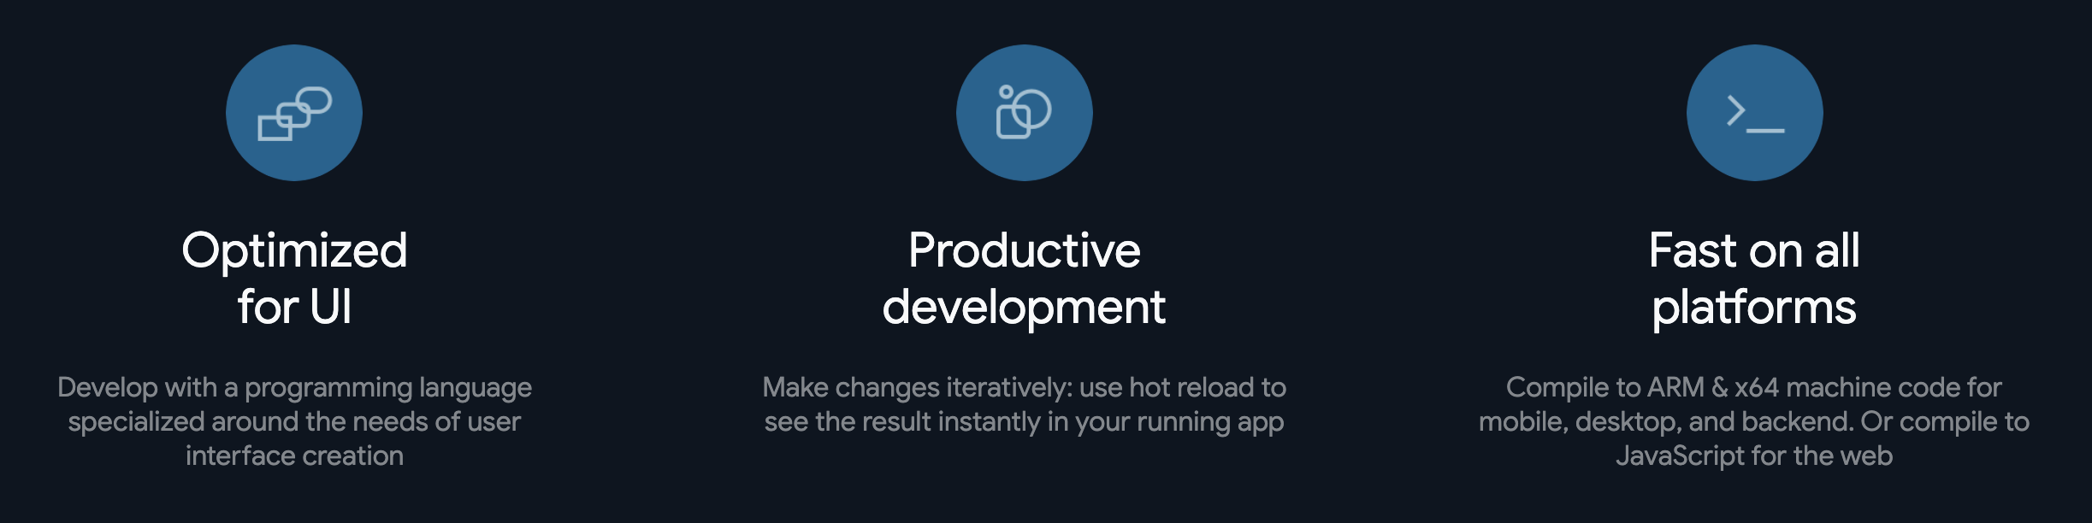

What is Dart?
Dart is a client-optimized language for fast apps on any platform.
https://dart.dev/
Notes:
Brand-driven == customized
Internal teams at Google (CRM system) have managed to build functioning prototypes in a week.
Designers with 0 coding experiences became productive with Flutter in weeks - allowing them to build prototypes in hours.

Slide 3
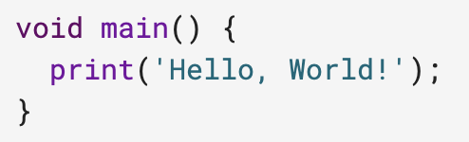
Hello World
Every app has a main() function.
To display text on the console, you can use the top-level print() function:
Notes:
The beauty of hot reload is, that even after fixing an error, state is still maintained - allowing to iterate and develop far quicker.

Slide 4
Topics
Variables
Control flow statements
Functions
Comments
Inheritance
Mixins
Interfaces and abstract classes
Async
Exceptions
Notes:
Brand-driven == customized
Internal teams at Google (CRM system) have managed to build functioning prototypes in a week.
Designers with 0 coding experiences became productive with Flutter in weeks - allowing them to build prototypes in hours.

Slide 5
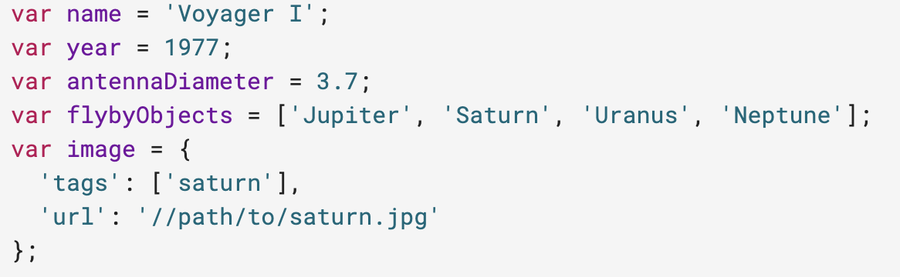
Variables
Even in type-safe Dart code, most variables don’t need explicit types, thanks to type inference:
Read more about variables in Dart, including default values, the final and const keywords, and static types.
Notes:
The beauty of hot reload is, that even after fixing an error, state is still maintained - allowing to iterate and develop far quicker.

Slide 6
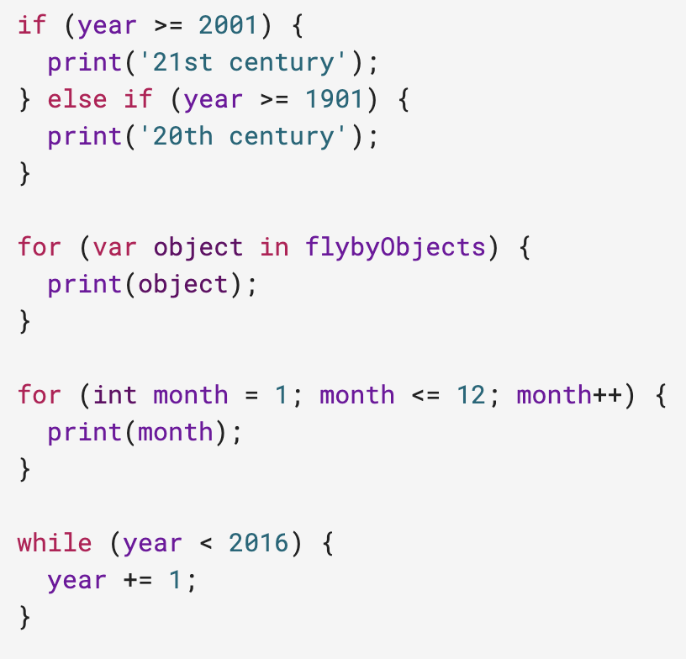
Control flow statements
Dart supports the usual control flow statements:
Read more about control flow statements in Dart, including break and continue, switch and case, and assert.
Notes:
Also available via IntelliJ’s built-in debugger

Slide 7
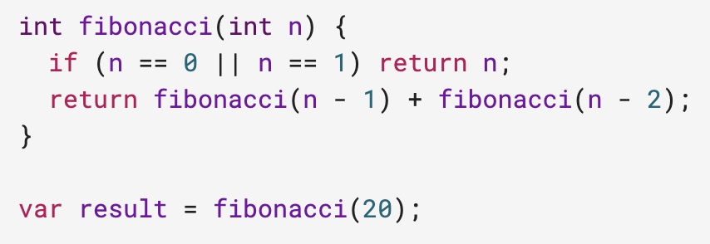
Functions
We recommend specifying the types of each function’s arguments and return value:

Slide 8
A shorthand => (arrow) syntax is handy for functions that contain a single statement. This syntax is especially useful when passing anonymous functions as arguments:

Slide 9
Besides showing an anonymous function (the argument to where()), this code shows that you can use a function as an argument: the top-level print() function is an argument to forEach().
Read more about functions in Dart, including optional parameters, default parameter values, and lexical scope.

Slide 10
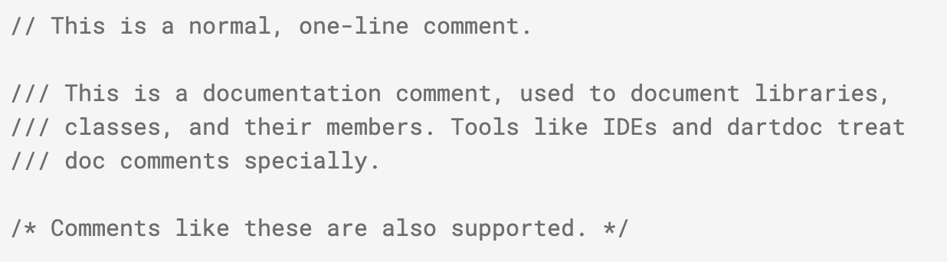
Comments
Dart comments usually start with //.
Read more about comments in Dart, including how the documentation tooling works.

Slide 11
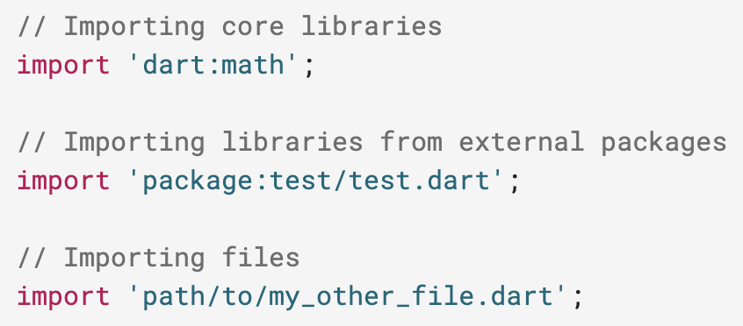
Imports
To access APIs defined in other libraries, use import.
Read more about libraries and visibility in Dart, including library prefixes, show and hide, and lazy loading through the deferred keyword.

Slide 12
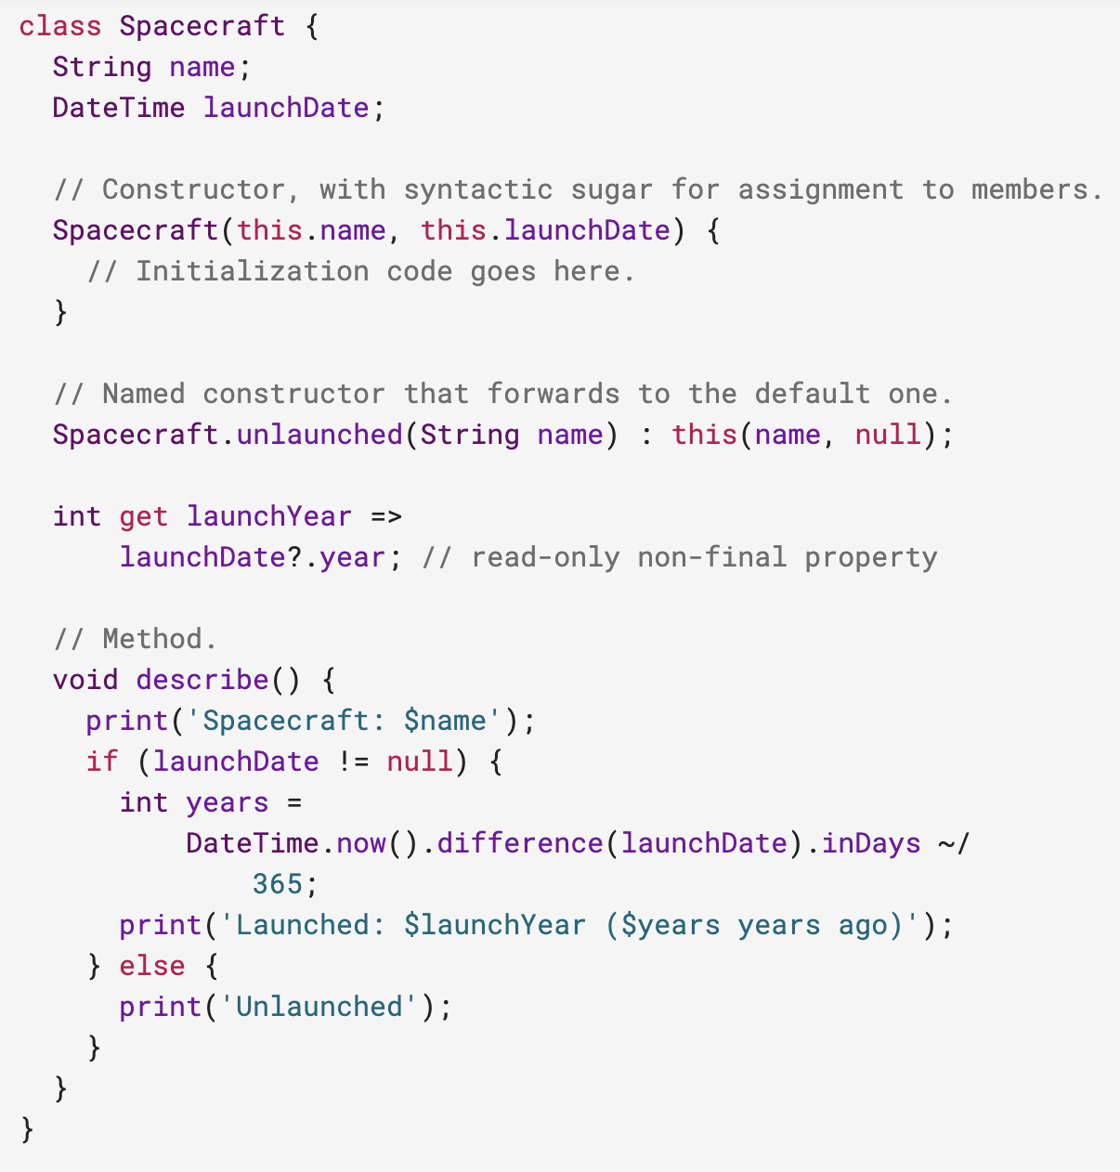
Classes
Here’s an example of a class with three properties, two constructors, and a method. One of the properties can’t be set directly, so it’s defined using a getter method (instead of a variable).

Slide 13
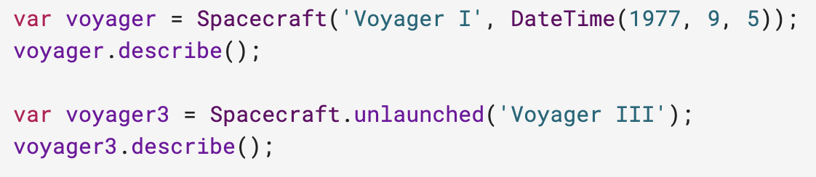
You might use the Spacecraft class like this:
Read more about classes in Dart, including initializer lists, optional new and const, redirecting constructors, factory constructors, getters, setters, and much more.

Slide 14
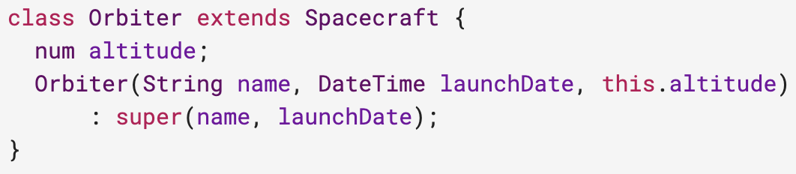
Inheritance
Dart has single inheritance.
Read more about extending classes, the optional @override annotation, and more.

Slide 15
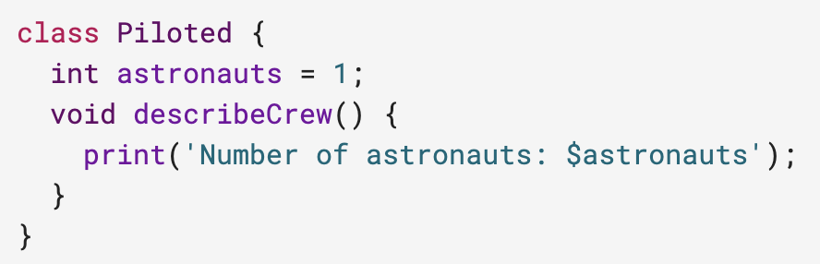
Mixins
Mixins are a way of reusing code in multiple class hierarchies. The following class can act as a mixin:

Slide 16
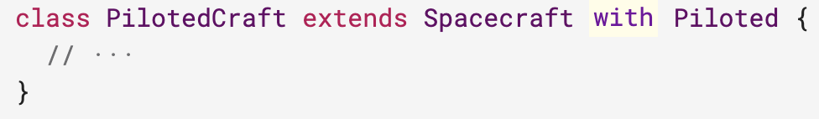
To add a mixin’s capabilities to a class, just extend the class with the mixin.
PilotedCraft now has the astronauts field as well as the describeCrew() method.
Read more about mixins.

Slide 17
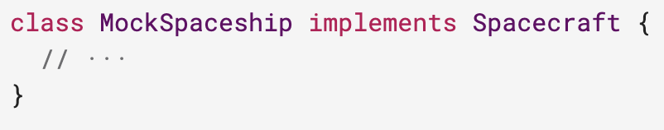
Interfaces and abstract classes
Dart has no interface keyword. Instead, all classes implicitly define an interface. Therefore, you can implement any class.
Read more about implicit interfaces.

Slide 18
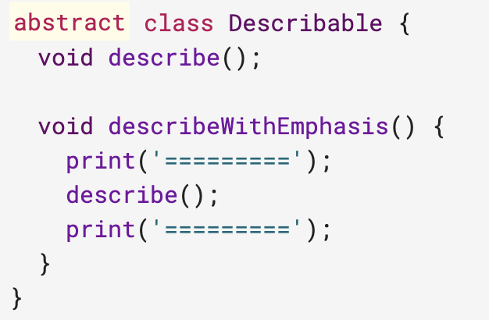
You can create an abstract class to be extended (or implemented) by a concrete class. Abstract classes can contain abstract methods (with empty bodies).
Any class extending Describable has the describeWithEmphasis() method, which calls the extender’s implementation of describe().
Read more about abstract classes and methods.

Slide 19
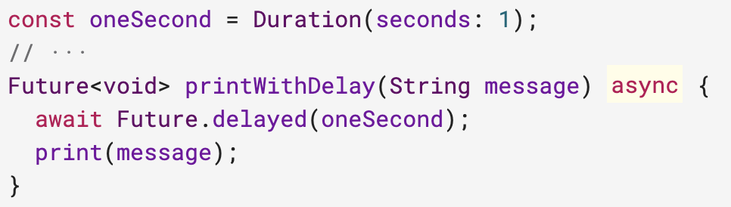
Async
Avoid callback hell and make your code much more readable by using async and await.

Slide 20
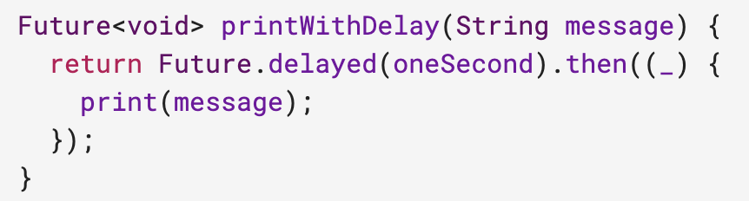
The method above is equivalent to:

Slide 21
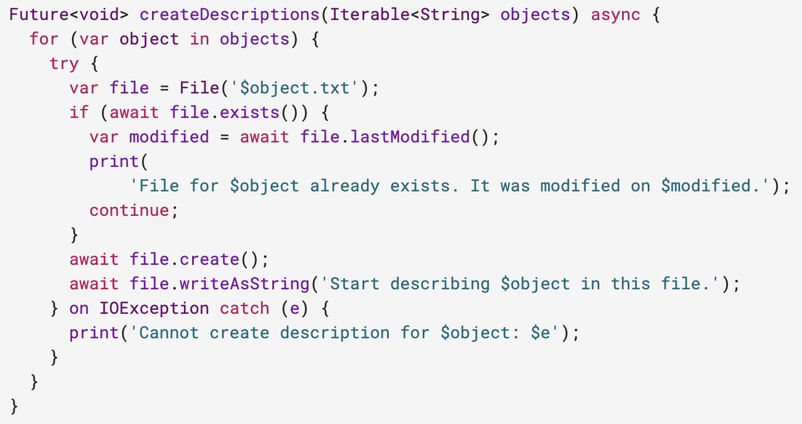
As the next example shows, async and await help make asynchronous code easy to read.

Slide 22
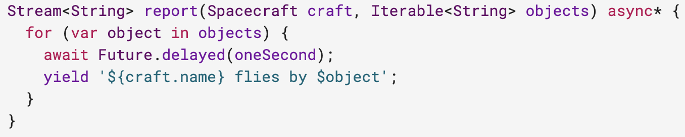
You can also use async*, which gives you a nice, readable way to build streams.
Read more about asynchrony support, including async functions, Future, Stream, and the asynchronous loop (await for).

Slide 23
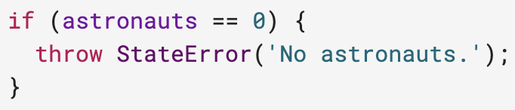
Exceptions
To raise an exception, use throw:
Read more about exceptions, including stack traces, rethrow, and the difference between Error and Exception.

Slide 24
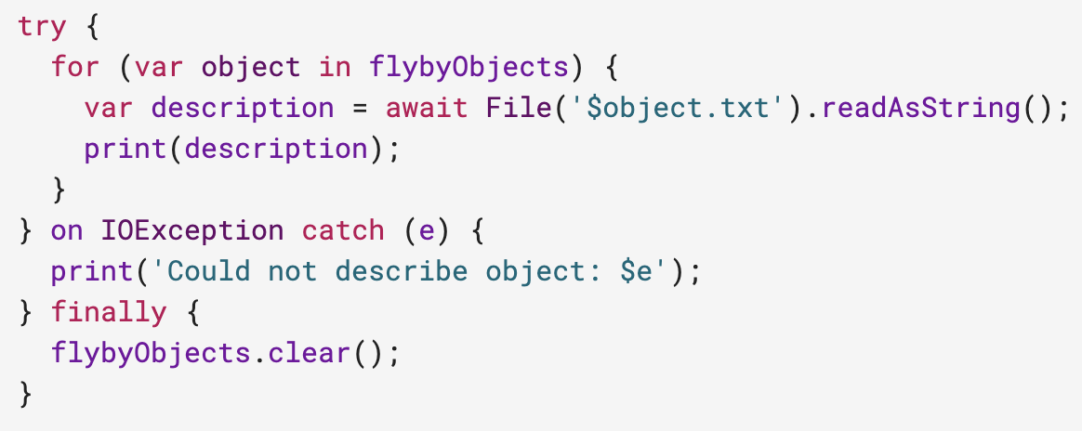
To catch an exception, use a try statement with on or catch (or both):

Slide 25
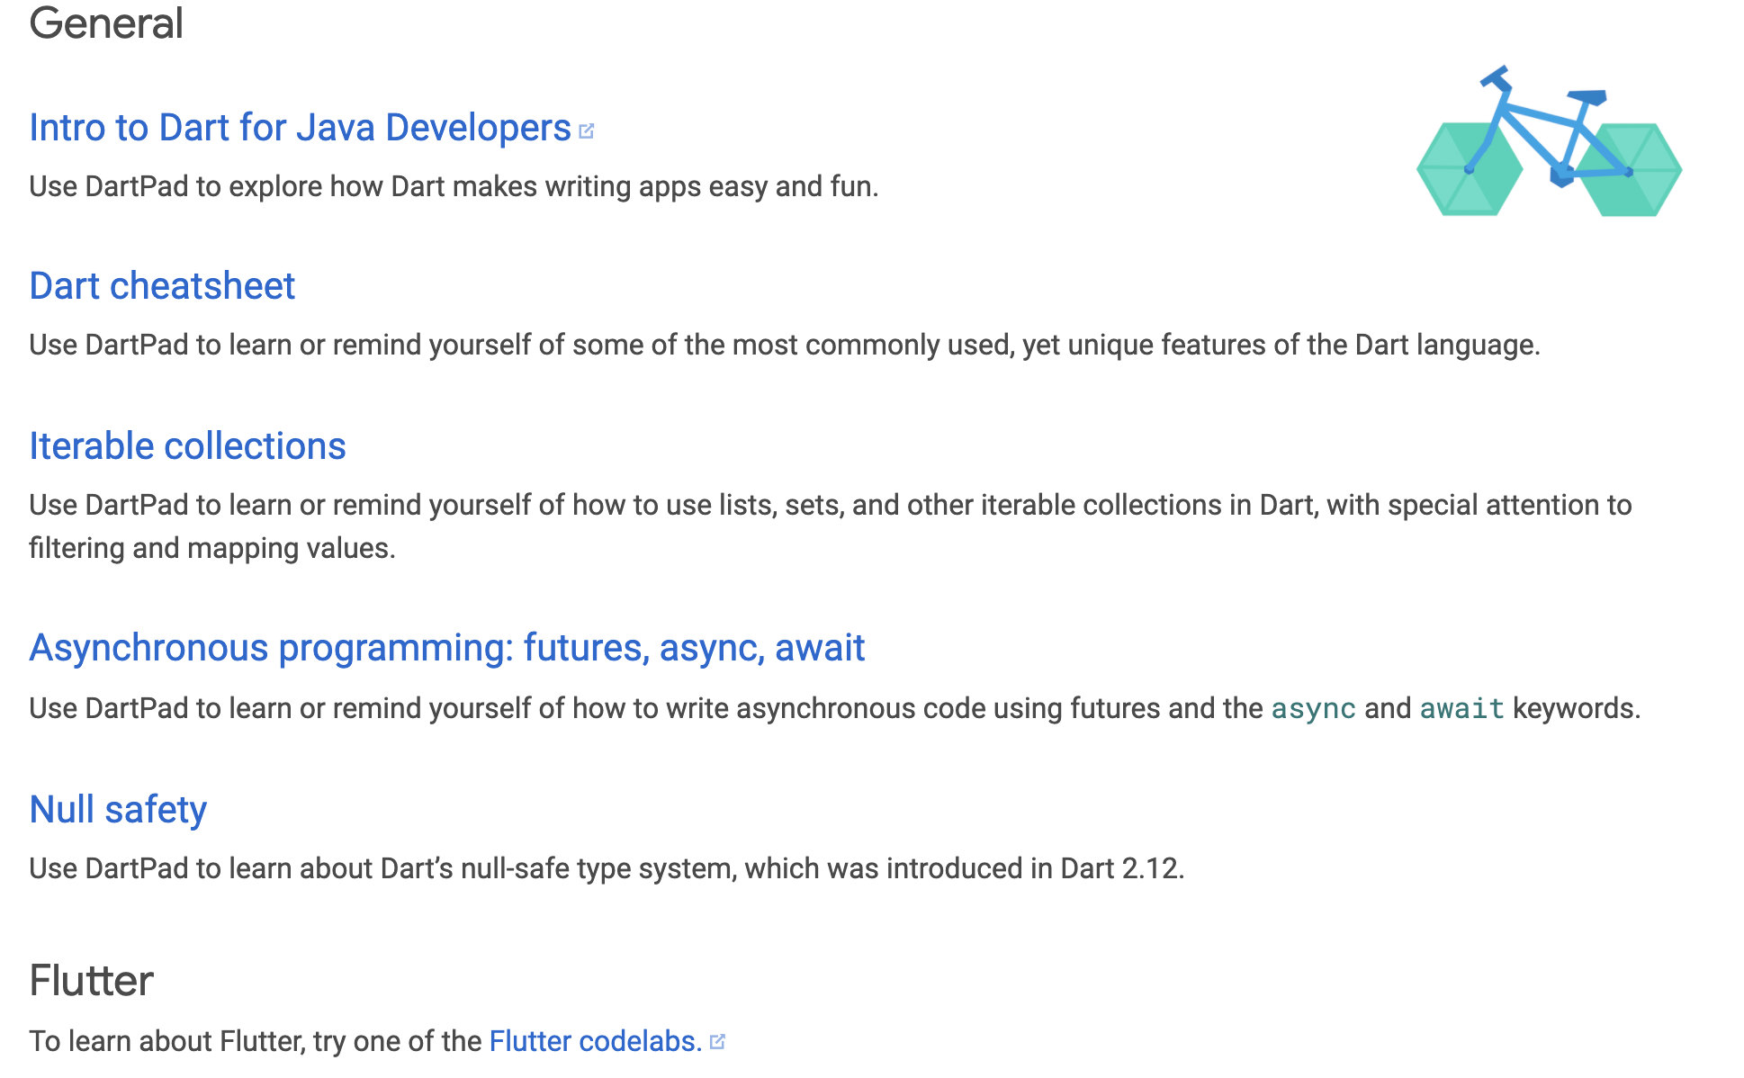
Other topics
Many more code samples are in the language tour and the library tour. Also see the Dart API reference, which often contains examples.
Codelabs: https://dart.dev/codelabs

Slide 26
Thank you!
Wenxuan Shi
College of Software, Nankai University
Email: shiwx@nankai.edu.cn
Wechat: 13920561100

